Slide 1
Philippe Pasquier & Ollie Bown
Christoffer Sommerfeld and garrett gredell

Slide 2

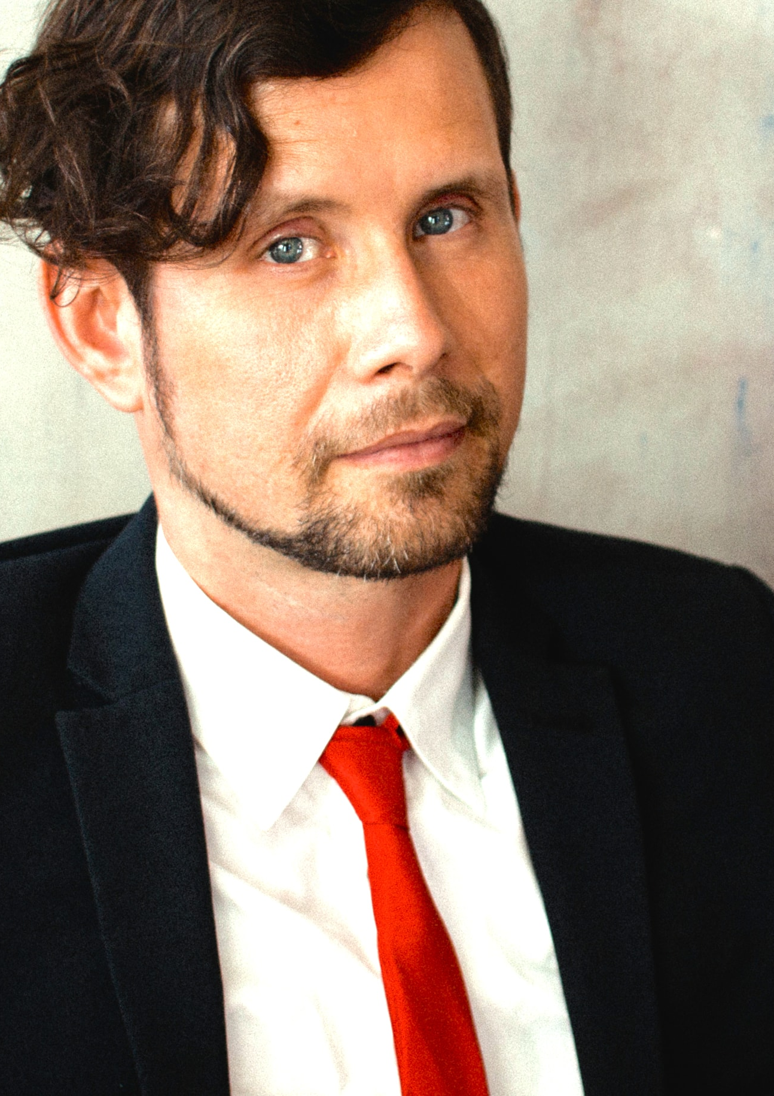
Who is Philippe Pasquier?
He is a French professor at the School of Interactive Arts at Simon Fraser University in Canada
He is a self-proclaimed artist and scientist pursuing knowledge and projects related to artificial intelligence.
He teaches a variety of computer based
Art courses with a focus on interactivity.
He is also a musician and a composer.

Slide 3

Philosophy
In regard to technology, Philippe believes that technology was originally created to aid with problem solving.
This has shifted in recent years though.
He believes technology is now used more often for creative/entertainment purposes (photoshop, video editing, etc.)
Seeks to make artificial intelligence autonomous and creative.

Slide 4
Works
AuMe- An interactive system that invites participants to enter a phrase into a "search engine"-like bar which plays sound effects based on the phrase or sentence. It is a dynamic audio experience
https://www.youtube.com/watch?v=Ohokz2iXTH8
Longing and Forgetting- An art display that was projected onto a large building in Canada. From a distance it seemed as though people were scaling the building. However, it was actually just prerecorded footage of several people moving around in an empty space.
https://www.youtube.com/watch?v=m1k7gn9_6ZI

Slide 5

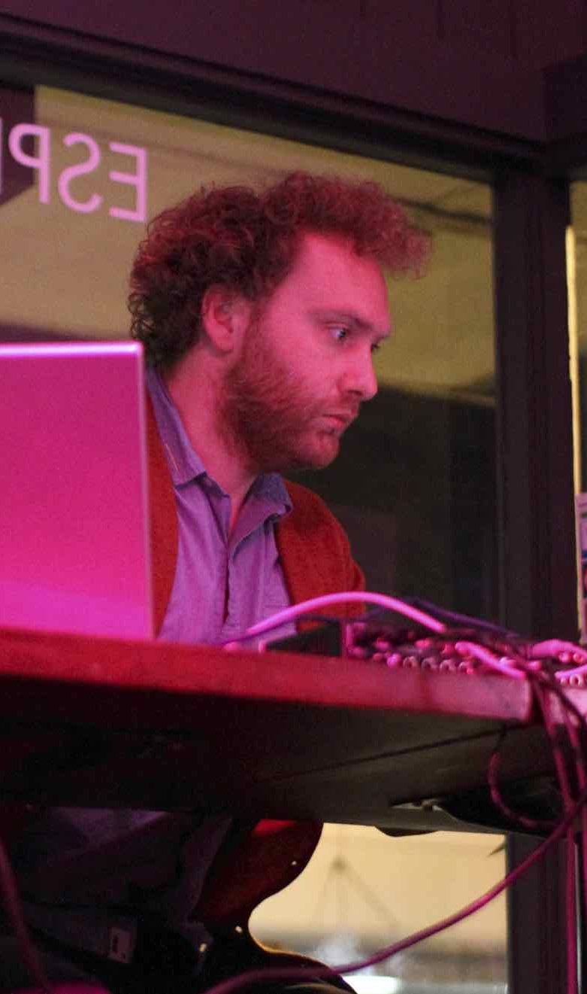



Ollie Bown

Slide 6
The Facts
Bachelors in Mathematics and Social Anthropology
Attended the University of Cambridge
Masters in evolutionary and adaptive systems at the University of Sussex
PhD for simulation models of the evolution of human musical behavior at the Intelligent Sound and Music Systems group at goldsmiths College, London.
People he has collaborated with include; Sam Britton, Tom Arthurts, Lothar Olhmeier, Maurizio Ravalico, Britt Hatzius, Martin Hampton, Rudi Fischerlehner and Oliver Dukert

Slide 7
DIADS
The Distributed Interactive Audio Devices
The members of the audience are invited to be a part of the piece through their interactions with a set of DIADS
Passing around a loudspeaker system
Rather than the audience being immersed in the surround sound, the sound sits amongst the audience.
The work takes the form of a live electronic music performance, with the performer on stage, controlling the DIADS remotely.

Slide 8
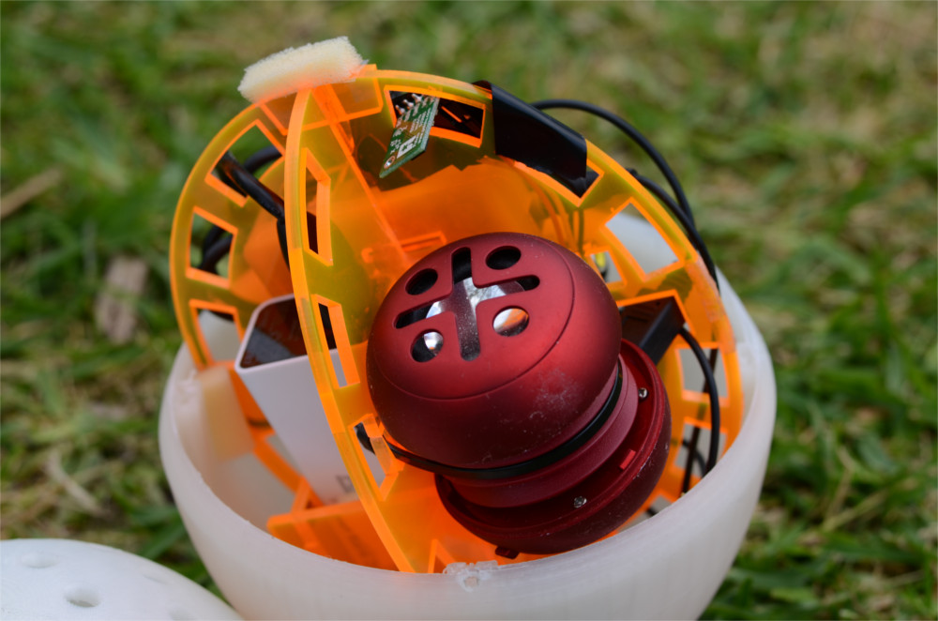
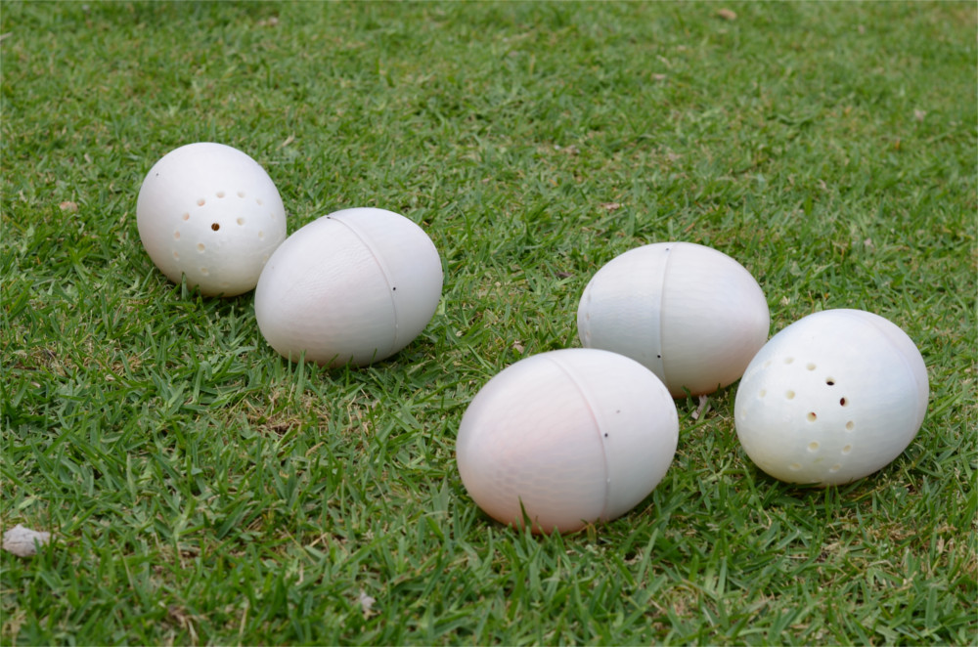
DIADS
https://vimeo.com/176422736

Slide 9
APHEX TWIN REMOTE ORCHESTRA
To create a live performance software for his remote orchestra project
The orchestra has no idea what the piece is going to sound like
The concept involved giving an entire 32 piece orchestra headphones, over which the simple tones could be sent for the players to match
The conductor controls the orchestra by changing the frequency sent to the musicians
Lights are used to direct time signatures.

Slide 10
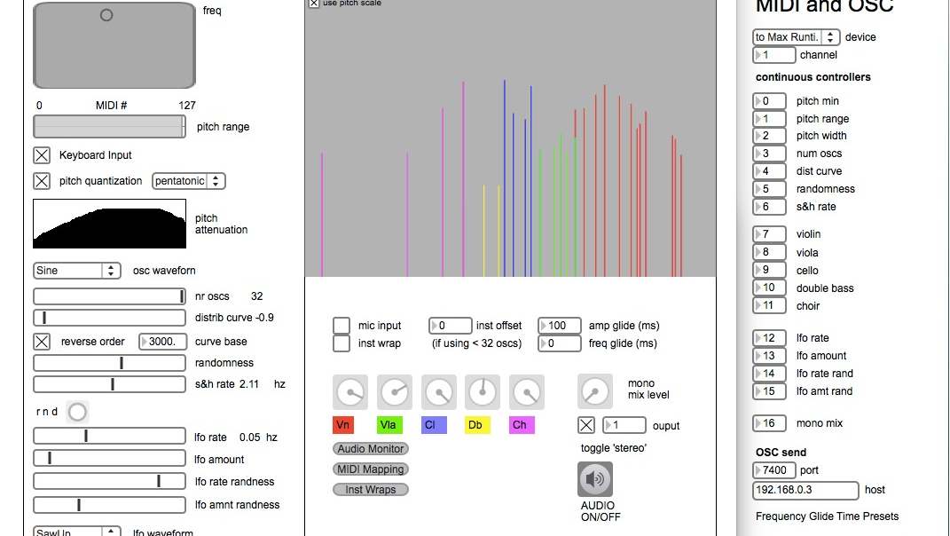
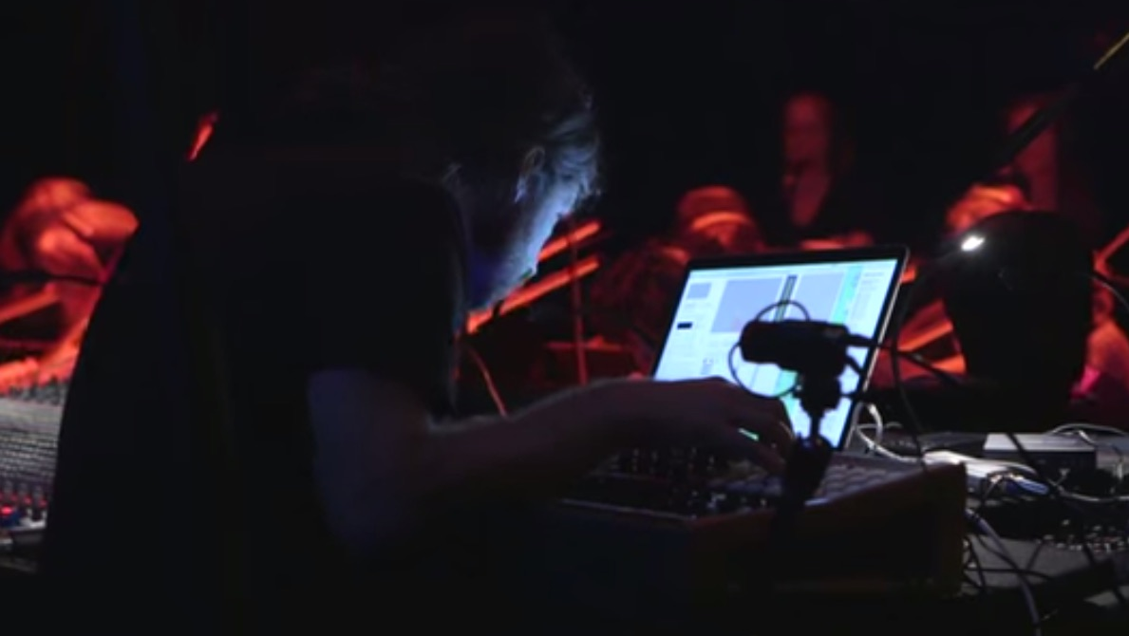
APHEX TWIN REMOTE ORCHESTRA
https://vimeo.com/30040716

